Slide 1
PhD - the Truth
View as slide show

Slide 2
Pass notes
The PhD
2017
Picture: Guardian Higher Education Network

Slide 3
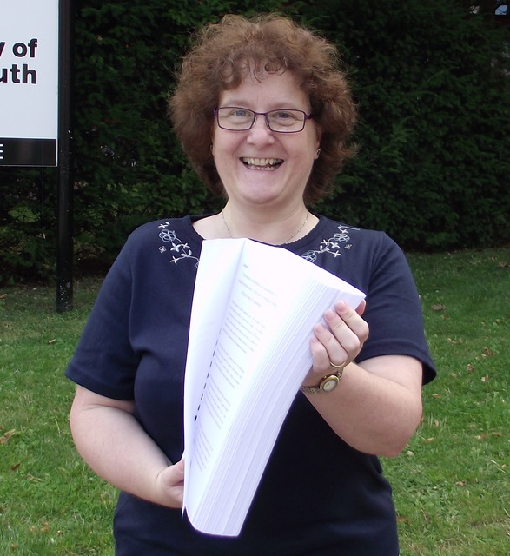

Slide 4
Age?
Medieval

Slide 5
Appearance?
100,000 words

Slide 6
Who writes them?
People who want to put Dr on their credit card

Slide 7
Who reads them?
Almost no-one

Slide 8
Sounds like a lot of work?
Supposed to take 3 years, 6 if part time

Slide 9
Supposed to?
Most students take 4 or 5, 8 or 10 if part time

Slide 10
Anyway, they get a scholarship with fees paid and a desk in the department?
Think opportunity costs

Slide 11
How do they know what to do?
They are given a postgraduate handbook and the QAA Code of Practice

Slide 12
What do these say?
Did you read the conditions when you downloaded your smartphone update?

Slide 13
But they get help, I suppose?
An academic meets them 6 times a year to provide supervision, 3 times if part time

Slide 14
Aren’t these supervisors available in between?
They are not promoted for nannying students

Slide 15
But when they are not researching, attending conferences, writing articles, teaching and examining?
Heard of the long vacation?

Slide 16
Ah, but I imagine these supervisors have been through a thorough training to provide good support?
They are scholars not plumbers

Slide 17
But they can ensure it’s successful?
They are forbidden to conduct the examination

Slide 18
And so the examiners are..?
Two other scholars

Slide 19
Who are ...experts in examining?
Remember previous answer?

Slide 20
But rewarded handsomely?
See National Minimum Wage

Slide 21
And are told to apply precise criteria?
I’ve told you, they are scholars

Slide 22
How is the work graded?
Just pass or fail

Slide 23
But they can appeal if they fail?
Not on grounds of poor supervision. They should have submitted their complaint earlier.

Slide 24
But there’ll be bereavement counseling if their appeal fails?
They will have been deregistered and can only go to the OIA (or Ombudsman in Scotland)

Slide 25
OIA? Ombudsman?
A team of lawyers in Reading (or Edinburgh)

Slide 26
...who can provide help?
Not if it’s a matter of academic judgment

Slide 27
Anyway, those who complete can step straight into a university post?
In HR

Slide 28
But I thought they hoped to become professors?
They could be offered graduate teaching assistant job or a post-doc

Slide 29
Great. Then a mortgage and a lifetime of scholarship with superannuation for their retirement?
These jobs are temporary and often zero hour contacts

Slide 30
But my Mum tells me that her Daily Mail says they can earn nearly half a million per annum and get free serviced accommodation
Shows there are no glass ceilings at Bath

Slide 31
Do say
Our higher degrees are the cornerstone of UK Higher Education

Slide 32
Don’t say
I just wanted my name to be on the article my supervisor published from my research

Slide 33
Fin
©
johnwakeford@icloud.com

